Slide 1
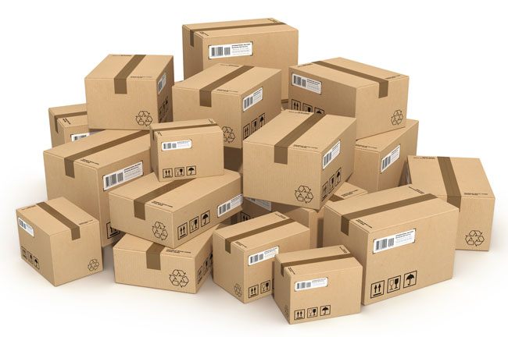
Oracle 11g Objects
Packages

Slide 2
Packages
Packages are groups of procedures, functions, variables, and SQL statements grouped together into a single unit.
To execute a procedure within a package, you must first list the package name, and then list the procedure name, as shown in the following example:
execute BOOK_INVENTORY.NEW_BOOK('ONCE REMOVED');
Packages allow multiple procedures to use the same variables and cursors. Procedures within packages may be either available to the
public or
private, in which case they are only accessible via commands from within the package

Slide 3
Commands
Packages may also include commands that are to be executed each time the package is called, regardless of the procedure or function called within the package.
Thus, packages not only group procedures but also give you the ability to execute commands that are not procedure specific

Slide 4
Example: create procedure
First lets create the procedure
create or replace procedure NEW_BOOK (aTitle IN VARCHAR2, aPublisher IN VARCHAR2, aCategoryName IN VARCHAR2)
as
begin
insert into BOOKSHELF (Title, Publisher, CategoryName, Rating)
values (aTitle, aPublisher, aCategoryName, NULL);
delete from BOOK_ORDER
where Title = aTitle;
end;

Slide 5
Create Package
create [or replace] package [user.] package
[authid {definer | current_user} ]
{is | as}
package specification;
A package specification consists of the list of functions, procedures, variables, constants, cursors, and exceptions that will be available to users of the package.

Slide 6
Create Package Example: specification
create or replace package BOOK_MANAGEMENT
as
function OVERDUE_CHARGES(aName IN VARCHAR2) return NUMBER;
procedure NEW_BOOK (aTitle IN VARCHAR2, aPublisher IN VARCHAR2, aCategoryName IN VARCHAR2);
end BOOK_MANAGEMENT;
Package specification

Slide 7
Package Body
create [or replace] package body [user.] package body
{is | as}
package body;
A package body contains the blocks and specifications for all of the public objects listed in the package specification.
The package body may include objects that are not listed in the package specification; such objects are said to be private and are not available to users of the package.
A package body may also include code that is run every time the package is invoked, regardless of the part of the package that is executed.

Slide 8
Package Body
create or replace package body BOOK_MANAGEMENT as
function OVERDUE_CHARGES (aName IN VARCHAR2) return NUMBER is
owed_amount NUMBER(10,2);
begin
select SUM(((ReturnedDate-CheckoutDate) -14)*0.20)
into owed_amount
from BOOKSHELF_CHECKOUT
where Name = aName and (ReturnedDate- CheckoutDate) > 14;
RETURN(owed_amount);
EXCEPTION
when NO_DATA_FOUND THEN
RAISE_APPLICATION_ERROR(-20100, 'No books borrowed.');
end OVERDUE_CHARGES;
procedure NEW_BOOK (aTitle IN VARCHAR2,
aPublisher IN VARCHAR2, aCategoryName IN VARCHAR2)
is
begin
insert into BOOKSHELF
(Title, Publisher, CategoryName, Rating)
values (aTitle, aPublisher, aCategoryName, NULL);
delete from BOOK_ORDER
where Title = aTitle;
end NEW_BOOK;
end BOOK_MANAGEMENT;

Slide 9
Package Body: extra code
create or replace package body BOOK_MANAGEMENT as
function OVERDUE_CHARGES (aName IN VARCHAR2) return NUMBER is
owed_amount NUMBER(10,2);
begin
select SUM(((ReturnedDate-CheckoutDate) -14)*0.20)
into owed_amount
from BOOKSHELF_CHECKOUT
where Name = aName and (ReturnedDate- CheckoutDate) > 14;
RETURN(owed_amount);
EXCEPTION
when NO_DATA_FOUND THEN
RAISE_APPLICATION_ERROR(-20100, 'No books borrowed.');
end OVERDUE_CHARGES;
procedure NEW_BOOK (aTitle IN VARCHAR2,
aPublisher IN VARCHAR2, aCategoryName IN VARCHAR2) is
begin
insert into BOOKSHELF
(Title, Publisher, CategoryName, Rating)
values (aTitle, aPublisher, aCategoryName, NULL);
delete from BOOK_ORDER
where Title = aTitle;
end NEW_BOOK;
begin
select User, SysDate
into User_Name, Entry_Date
from DUAL;
end BOOK_MANAGEMENT;
end BOOK_MANAGEMENT;
Packages may include code that is to be run the first time a user executes a function or procedure in the package within each session.

